Slide 1
OLE and ODBC: Taming the Technologies
The Third Annual Perl Conference, 1999
OLE
Roth Consulting
Sunday, August 22, 1999
Notes:
Most people do not thing twice about an application linking ot another application.

Slide 2
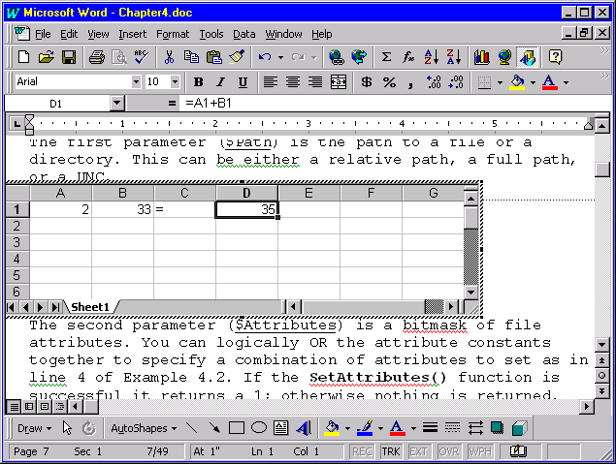
OLE: Object Linking and Embedding
OLE is just the technology which allows an object (such as a spreadsheet) to be embedded (and linked) inside of another document (a word processor document).
Notes:
Most people do not thing twice about an application linking ot another application.

Slide 3
OLE: Object Linking and Embedding
II
Version 1 used DDE to communicate between applications.
Version 2 uses COM instead of DDE (although DDE still exists for legacy reasons)
Perl focuses more on COM than OLE.

Slide 4
COM: Component Object Model
Microsoft technology.
COM is the protocol which allows OLE to work
  Rules of the road for programs to talk with each other
  Foundation of automation

Slide 5
What is Automation?
Automation is the ability to control an application from another.
Sometimes referred to as scripting.
For example, Perl script starts Excel, loads spreadsheet, adds data, saves, quits Excel.
Visual Basic for Applications (VBA) is a scripting language which makes use of automation.
Perl (and PerlScript) makes use of automation.

Slide 6
COM vs OLE: A Fair Fight?
They are totally different from each other
OLE is like the ability to embed a letter within an envelope
COM is like how to fold the letter, what size the envelope must be to fit the letter and other rules such as where to put the stamp and address on the letter (then where to take to the letter)
The Win32::OLE extension could (and maybe should) have been called Win32::COM
  Users may have confused it for an extension that manages serial ports

Slide 7
COM terms to know
COM object: A chunk of memory which represents a particular COM interface
COM collection: A group of similar COM objects
controller process: Process or application which will play with COM objects. This process “controls” a COM server
interface: Specific API that is built into a COM object
automation: Ability to control COM objects without having to know how the COM object was designed

Slide 8
COM terms to know
II
object model: The blueprints for a COM object
COM server: The thing that generates COM objects
  in-proc: In process; this COM server is a DLL which the controller process loads into it’s own memory space
  out-of-proc: Out of process; this COM server is a process separate from the controlling process. Could even be running on another machine

Slide 9
COM Objects
A COM object is a set of functions and data
Functions
  Called methods
  Perform an action
    Returns a result such as an numeric value, a string and array or another COM object
  Example
    Print()
    GetAddress()

Slide 10
Objects
II
Data
  Called properties
  Some properties are read/write so they can be both set and queried
  Some properties are read-only so they can only be queried
  Properties can be a numeric value, a string, an array or another COM object
  Example
    Count
    CurrentDate
    Font

Slide 11
COM Collection Object
Special type of COM object which represents a bunch of other COM objects
COM Collection object is similar to a Perl array which contains a list of COM objects
A collection object typically has a name which is the plural of the type of COM object it represents
  Fonts would represent a collection of Font COM objects
  Documents would represent a collection of Document COM objects

Slide 12
What is an Object Model?
Consider an object model to be the blueprint for the way an object oriented class works
  Just as a car manufacture creates a model of a car before designing it so does the author of a COM object
  The object model literally models the methods (functions) and members (variables) that a COM object has An object model defines a set of functions (methods) and variables (members or properties)
Each set of functions are grouped together and is called an Interface
  Interfaces are API’s
  API => Application Programming Interface

Slide 13
What is an Object Model ?
II
It’s the infrastructure, silly!
All Active-X and OLE controls have such blueprints (or object models)

Slide 14
COM consists of interfaces, interfaces, interfaces
COM defines interfaces into a program.
Each interface has an unique interface id (IID) to identify it from other interfaces:
  {000209FF-0000-0000-C000-000000000046}
  {00020906-0000-0000-C000-000000000046}
  Aka GUID, CLSID, UUID, ProgID
  Stored in Registry: HKEY_CLASSES_ROOT\CLSID
In theory an IID is so unique that no two interfaces will ever have the same ID; regardless of vendor, program or platform.

Slide 15
COM consists of interfaces, interfaces, interfaces
II
Each interface can have a class name in addition to an IID:
  “Word.Application”
  “Word.Document”
  Stored in Registry: HKEY_CLASSES_ROOT

Slide 16
General model of use
Basically there is a general model of use:
  1) A typical controller process will request that a COM server generate a COM object.
  2) The server is loaded or located, the request is submitted, a response is returned.
  3) If request results in a valid COM object then controller process interacts with the object.
  4) Destroy COM object.

Slide 17
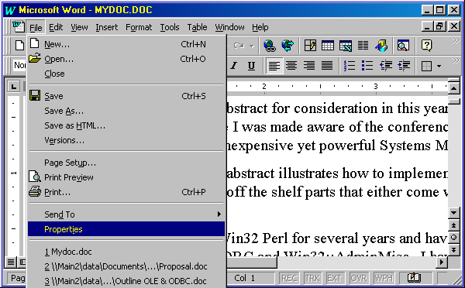
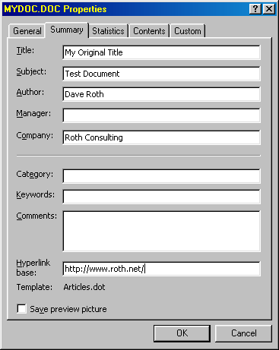
What does all this mean?
Let’s say we need to change the title and subject of a Microsoft Word document
1) Need to somehow run Word
2) Need to load up the document
3) Need to change the title and subject
4) Need to save the document
5) Need to quit Word

Slide 18
What does all this mean ?
II
How would we implement such a system?
  1) Request a Word application COM object
  2) Call a function in the Word application COM object which loads a document. It returns a Word document COM object
  3) Modify the Title and Subject properties from the Word document COM object
  4) Call into the Word document COM object to save to disk
  5) Destroy both the document and application COM objects

Slide 19
Using Win32::OLE
To use the Win32::OLE extension (thus be able to manipulate COM objects) you must first load the extension:
use Win32::OLE;

Slide 20
Procuring a COM object
Request a new COM object
  $Obj = new Win32::OLE( “Word.Application” );
  $Obj = Win32::OLE->new( “Word.Application” );
Optional Second parameter is function to call when terminating the object
  Some COM servers do not clean up after themselves such as Excel so you can pass in a second parameter which specifies a function to call when the object is destroyed
  $Obj = Win32::OLE->new( “Excel.Application”, \&TerminateExcelApp );
  Can be a string representing a method to call from within the COM object such as “Quit”

Slide 21
Procuring a COM object
II
Requesting a COM object from a remote machine via DCOM
  You must replace the first parameter with an anonymous array consisting of (in order):
    The remote machine
    The class of the COM object to be procured
  $Obj = Win32::OLE->new( [ “my.machine.com”,
  “Excel.Application” ], \&TerminateExcelApp );

Slide 22
Procuring a COM object
III
Request a COM object from the pool of already existing objects.
  Usually works with non in-proc COM servers
  Minimizes memory and processor overhead
  $Obj = Win32::OLE->GetActiveObject( “Word.Application” );
  Fails if the object does not already exist in memory

Slide 23
Procuring a COM object
IV
Request a COM object from a file (aka a persistent COM object):
$Obj = Win32::OLE->GetObject( ‘c:\mystuff.doc’ );
Fails if:
  file does not exist
  unable to determine the file type
  the application is not registered with the Registry
  the application is not installed
  something else goes drastically wrong

Slide 24
Procuring a COM object
V
Some COM objects can not have multiple instances of itself therefore you need to use the GetActiveObject() function.
  Many services such as IIS behave this way:
    $IIS = Win32::OLE->GetActiveObject( “IIS://localhost/” );
Other COM objects that are allowed multiple instances (Excel, Word, Netscape, IE, etc) can be obtained via GetActiveObject() to conserve memory/processor overhead

Slide 25
Procuring a COM object
VI
A Trick:
If you use GetActiveObject() to conserve memory and the COM object can have multiple instances then upon the function failing you could request a new instance of the COM object:
  my $Obj;
  my $Class = “Word.Application”;
  if( ! $Obj = Win32::OLE->GetActiveObject( $Class ) )
  {
  $Obj = Win32::OLE->new( $Class ) ||
  die “Can not obtain a $Class object\n”;
  }

Slide 26
Querying a COM object’s type
At this point we have a Word Application COM object (or we died and terminated the script)...
We can make sure the object is indeed a Word Application object with the
Win32::OLE->QueryObjectType( $Obj );
The function will return a text string representing the type of object: “Word_Application”
Usually this is only needed on objects that of an unknown type
If a function returns an unknown COM object use QueryObjectType()to determine its type

Slide 27
COM Object properties
We can now mess around with the Word document COM objects properties...
One of a Word application COM objects many properties is the Visible property. This renders the Word application either visible or invisible to the user (by default it is invisible):
$Word->{Visible} = 1;
Another property is a collection of documents that Word currently has open:
$Docs = $Word->{Documents};
Notes:
A property is really a method with a “propget” attribute. If the function is read only then it’s object model definition is:
some-data-type Attribute()
if it is read write then there will be another prototype in addtion to the read only one:
some-data-type Attribute( some-other-data-type )
The read/write prototype allows for some type of data to be passed in. This is the same as setting the property.
Example (Word.Application object):
Bool Visible()
Bool Visible( Bool )
Documents* Documents()
There are two properties, Visible and Documents. Visible can be set but Documents is read ony. Visible returns a boolean and Documents returns a COM Collection of Document COM objects.
NOTE: It is possible to do this:
$Word->Documents( 2 )
which returns the second document in the $Word->Documents() object. This is done by reading the read only value $Word->{Documents} then performing the “default” action on the returnd Documents object which is Item(). This is equivilent to:
$Word->{Documents}->Item( 2 );

Slide 28
COM Object properties
II
Properties are really functions. Thus the following are equivalent:
  $Obj->{Visible};
  $Obj->Visible();
Likewise to set a property, the following are equivalent:
  $Obj->{Visible} = 1;
  $Obj->Visible( 1 );

Slide 29
COM Object properties
III
Some properties are COM objects or COM collection objects:
  $Docs = $Obj->{Documents};
  $Doc1 = $Docs->Item( 1 );
  print $Doc1->{Path};
You can call a default method indirectly by passing in parameters. The above is equivalent to :
  $Doc1 = $Obj->Documents( 1 );
  print $Doc1->{Path};
NOTE: This makes the Documents property appear as a method, but it is only a property!

Slide 30
Calling COM object methods
In our Word example we have a COM object which represents the Microsoft Word program. Now we need to load a document
The Word application COM object has an Open() method which will open and load a Word document
The method returns a Word document COM object
Method calls are made just like a call into a Perl object:
$Doc = $Obj->Open( ‘c:\temp\myfile.doc’ );

Slide 31
Calling COM object methods
II
Some methods have optional parameters. This can pose a problem if you need to only specify some of them
Open() has the following syntax:
Document* Open( FileName,
[optional] ConfirmConversions,
[optional] ReadOnly,
[optional] AddToRecentFiles,
[optional] PasswordDocument,
[optional] PasswordTemplate,
[optional] Revert,
[optional] WritePasswordDocument,
[optional] WritePasswordTemplate,
[optional] Format );

Slide 32
Calling COM object methods
III
With optional parameters you can specify them by name, in any order
All required parameters must be placed first and in order
After the required parameters place all named parameters and values in an anonymous hash
  $Doc = $Word->Open( ‘c:\temp\myfile.doc’,
  { ReadOnly = > 1,
  AddToRecentFiles => 2 } );

Slide 33
Chaining property and methods
You can chain multiple method calls into one line:
$Path = $Word->{Documents}->Item( 1 )->{Path};
$Path = $Word->Documents( 1 )->{Path};

Slide 34
Parameter placeholders
To skip a parameter in a method use undef
$Obj->Blah( $Param1, undef, $Param2 );

Slide 35
Destroying COM objects
When finished with a COM object it is best to destroy it using undef:
  undef $Doc;
  undef $Word;
Calling DESTROY() method:
  $Obj->DESTROY();
When the COM object falls out of scope it will automatically be destroyed:
  sub Foo
  {
  my $Obj = Win32::OLE->new( $Class );
  $Obj->Blah();
  }

Slide 36
Constants
Most programs have constant values
To load constant values use Win32::OLE::Const
use Win32::OLE::Const $TypeLibName;
  can take three optional parameters:
  Load constants into a hash reference:
$Const = Win32::OLE::Const->Load( $TypeLibName );
Both the use and the Load options can take three other parameters
  Major version (only load if version major matches)
  Minor version (only load if version minor >=)
  Language (Language ID; requires Win32::OLE::NLS)

Slide 37
Enumerating a Collections properties
Elements in a COM Collection object can be enumerated with the Perl keys function:
  foreach keys( %$Word )
  {
  print “$Word->{$_}\n”;
  }
Returns the names of properties

Slide 38
With and In
Win32::OLE allows for the use of the Visual Basic with and in commands
When loading the extension you must export the keywords:
  use Win32::OLE ‘in’;
  use Win32::OLE ‘with’;
  use Win32::OLE qw( in with );

Slide 39
With and In
: with
Allows for the setting of multiple properties on one object hence simplifies your code
Syntax: with( $Obj,
Property1 => Value1,
Property2 => Value2,
Propertyn => Valuen )
$Doc->{BuiltinDocumentProperties}->{Title} = “My Title”;
$Doc->{BuiltinDocumentProperties}->{Author} = “My Name”;
$Doc->{BuiltinDocumentProperties}->{Subject} = “My Subject”;
becomes
with( $Doc->{BuiltinDocumentProperties},
Title => “My Title”,
Author => “My Name”,
Subject => “My Subject” );

Slide 40
With and In
: in
Works only on COM Collection Objects
Similar to using keys except that COM objects are returned, not strings
Returns an array of COM objects
Using the in function the Perl code
$Count = $Obj->Count();
while( $Count )
{
print $Docs->BuiltinDocumentProperties( $Count )->{Value};
print “\n”;
}
Becomes
map { print "$_->{BuiltinDocumentProperties}->{Title}->{Value}\n"; } ( in( $Docs ) );

Slide 41
Variants
Perl to communicates with COM objects by converting Perl formats to COM formats
  Perl strings => UNICODE, length prefixed, nul termianted strings (BSTR’s)
  Perl Floats => C doubles
Normally this is done invisibly to the user but some times user intervention is required
  How does Win32::OLE know that a Perl string really is packed binary data?
  If you have $Value = 32 and a COM object expects a floating point value. Win32::OLE may convert $Value to an integer, not a float

Slide 42
Variants
II
COM uses a data structure called a variant to hold data
You can create your own variant
  use Win32::OLE::Variant;
  $Var = Variant( VT_R8, “32.00” );
  $SomeComObj->{Price}->{Value} = $Var;
Pass the variant into methods as if it was a parameter

Slide 43
Variants
III
Data Types
  VT_BOOL Boolean
  VT_BSTR String
  VT_CY 64 bit currency
  VT_DATE Date (COM internally uses double)
  VT_DISPATCH Win32::OLE object
  VT_EMPTY Void of any value (not undef)
  VT_ERROR Internal COM/OLE result codes
  VT_I2 Signed short integer (2 bytes)
  VT_I4 Signed short integer (4 bytes)
  VT_R4 Float (4 bytes)
  VT_R8 Double (8 bytes)
  VT_UI1 Unsigned character (1 byte)
  not unicode
  VT_VARIANT Reference to another variant
  VT_UNKNOWN No Perl equivilent

Slide 44
Errors
Last COM/OLE error can be retrieved:
  Win32::OLE->LastError()
Returned result depends upon context of the call.
  Numeric context returns error code
    print 0 + Win32::OLE->LastError();
  other scalar context returns error string
    print Win32::OLE->LastError();

Slide 45
Tricks about COM objects
Reference Counters
  Every time a COM object is referenced (requested) a counter (a reference counter) inside the COM server is incremented
  When the object is destroyed the COM server decrements the counter
  Only when the counter is 0 can the COM server be unloaded from memory
  This is why sometimes a buggy program which uses COM will fail to quit
  Win32::OLE takes care of any counter for you

Slide 46
Tricks about COM objects
Function and property names are not case sensitive
  $ComObj->Print() is same as $ComObj->prINt()
  $ComObj->{Name} is same as $ComObj->{naME}
Function can be accessed as properties
  $ComObj->Print() is same as $ComObj->{Print}
  Obviously no parameters can be passed

Slide 47
What does Win32::OLE not do?
Events:
  Events are experimental.
  Must be polled (no callbacks).
    Unlike coding in C++ if a COM object triggers an event (such as detecting a file has changed or a user inputted data) a Perl script can not have the COM object call a callback function.
    The Perl script must continuously poll for events by calling a special function.
  True COM event support may have to wait for a stable threaded version of Perl.
  This is why many Active-X components are not compatible.

Slide 48
What does Win32::OLE not do ?
II
Windowing
  Since Win32::OLE does not create a protected OLE container it is unable to enclose some COM objects – particularly those who need a UI to function.

Slide 49

Interacting with a COM object
Read about the object model!
  Use online documentation
  SDK’s!
  Use IDL files
  Use OLEVIEW.EXE to read .tbl, .dll, .exe type libraries

Slide 50
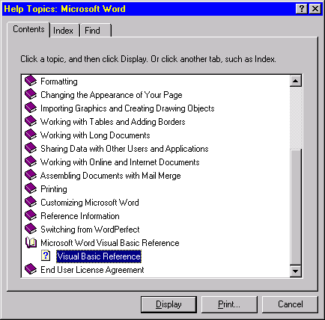
Documentation (online)
Read the online documentation!
Most Microsoft applications provide a Visual Basic Reference section in their help files

Slide 51
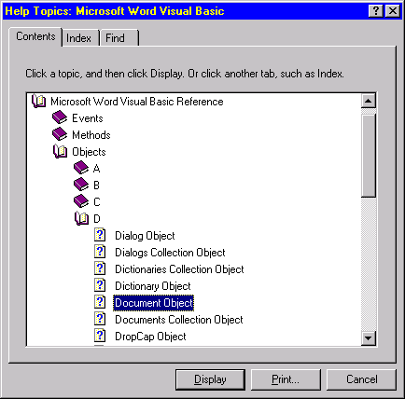
Documentation (online)
II
Study the object models for all the objects and collections
Each object and collection has methods and properties

Slide 52

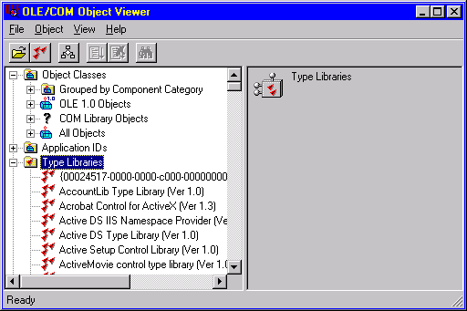
Documentation (oleview.exe)
Use the OleView.exe application
Found in Visual C++ and Microsoft’s platform SDK Tool (available on the MS web site)
Once open look through the “Type Libraries” tree
Here we see there are libraries for IIS, Acrobat, and ActiveMovie
Not seen are about 100 more libraries

Slide 53
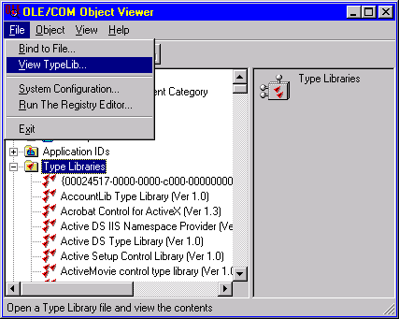
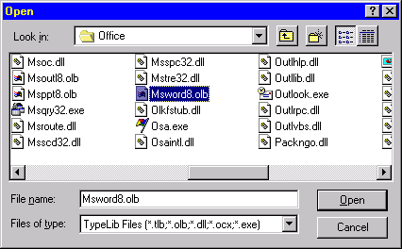
Documentation (oleview.exe)
II
You can choose the View menu and select “View Typelib…” to choose a non registered Type Library
Type library files: .tlb, .olb, .dll, .ocx, .exe

Slide 54
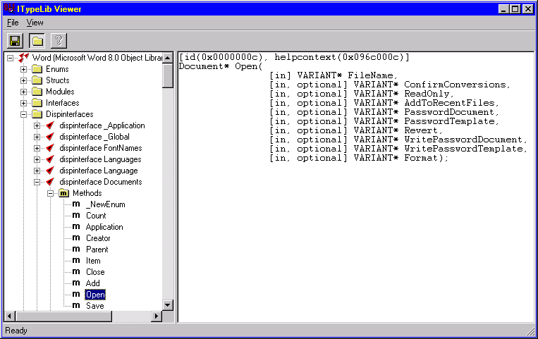
Documentation (oleview.exe)
III
Perl capable interfaces are under: Dispinterfaces
First parameter is necessary but the rest are optional
Returns a Document object
The Open method

Slide 55
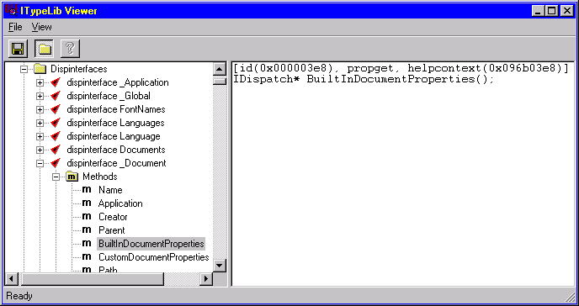
Documentation (oleview.exe)
V
Some properties & methods return an IDispatch object
Use Win32::OLE->QueryObjectType( $Obj ) to determine the object type

Slide 56
Example--Modify a Word doc
use Win32::OLE qw(in with);
my $Class = "Word.Application";
my $File = "c:\\temp\\MyTest.doc";
my $Word = Win32::OLE->GetActiveObject( $Class );
if( ! $Word )
{
$Word = new Win32::OLE( $Class, \&Quit ) ||
die "Can not create a '$Class' object.\n";
}
# By default a Word COM object is invisible (not
# displayed on the screen).
# Let's make it visible so that we can see what we
# are doing…
$Word->{Visible} = 1;
my $Doc = $Word->Documents->Add();
$Doc->BuiltInDocumentProperties( "Title" )->{Value} = "My Win32::OLE Test";
Run Script

Slide 57
Example--Modify a Word doc
…continued…
$SavePropertiesPrompt = $Word->Options->{SavePropertiesPrompt};
$Word->Options->{SavePropertiesPrompt} = 0;
$Doc->SaveAs( $File );
$Word->Options->{SavePropertiesPrompt} = $SavePropertiesPrompt;
$Doc->Save();
print "Hit enter to continue...\n";
<STDIN>;
$Doc->Close();
sub Quit
{
my( $Obj ) = @_;
$Obj->Quit();
}

Slide 58
Example II--Generating a chart
Run Script
use Win32::OLE qw( with in );
use Win32::OLE::Const "Microsoft Graph 8.0 Object Library";
my $TIME = time();
my $WIDTH = 640;
my $HEIGHT = 400;
my ( @CELLS ) = ( 'a'..'zz' );
my $File = "c:\\temp\\test.gif";
srand( time() );
$Class = "MSGraph.Application";
$Chart = new Win32::OLE( $Class ) ||
die "GO Away. Can not create '$Class'\n";
$Chart->{Visible} = 1;
$Data = $Chart->DataSheet();
$Graph = $Chart->Chart();
$Graph->{Width} = $WIDTH;
$Graph->{Height} = $HEIGHT;

Slide 59
Example II--Generating a chart
…continued…
$Graph->{HasLegend} = 0;
$Graph->{Type} = xlLine;
# Align the chart so it starts on the origin
$Graph->ChartGroups(1)->{HasUpDownBars} = 1 ;
$Graph->ChartGroups(1)->{HasUpDownBars} = 0;
# Add data to the graph
foreach $Value ( 0..33 )
{
my $Date = localtime( $TIME + 3600 * $Value );
$Data->Range( "$CELLS[$Value]0" )->{Value} = $Date;
$Data->Range( "$CELLS[$Value]1" )->{Value} = rand( 50 );
}

Slide 60
Example II--Generating a chart
…continued…
# Config the x-axis
if( $Axis = $Graph->Axes( xlCategory ) )
{
$Axis->{HasMajorGridlines} = 0;
$Axis->{TickLabels}->{orientation} = xlUpward;
with( $Axis->{TickLabels}->{Font},
Name => "Tahoma",
Bold => 0,
Italic => 0
);
}

Slide 61
Example II--Generating a chart
…continued…
# Config the y-axis
if( $Axis = $Graph->Axes( xlValue ) )
{
$Axis->{HasMajorGridlines} = 1;
$Axis->{MajorGridlines}->{Border}->{Weight} = 1;
# The color index 48 == 40% gray
$Axis->{MajorGridlines}->{Border}->{ColorIndex} = 48;
$Axis->{MajorGridlines}->{Border}->{LineStyle} = xlContinuous;
with( $Graph->Axes( xlValue )->{TickLabels}->{Font},
Name => "Tahoma",
Bold => 0,
Italic => 0
);
}

Slide 62
Example II--Generating a chart
…continued…
# Configure the data point labels for the series collection
$Graph->SeriesCollection( 1 )->{HasDataLabels} = 1;
if( $Labels = $Graph->SeriesCollection(1)->DataLabels() )
{
with( $Labels,
NumberFormat => "#.0",
Type => xlDataLabelsShowValues
);
with( $Labels->{Font},
Name => "Tahoma",
Bold => 0,
Italic => 0,
);
}

Slide 63
Example II--Generating a chart
…continued…
# Remove any data point labels if they are redundant
foreach my $Point (in( $Graph->SeriesCollection( 1 )->Points()))
{
my $Text = $Point->{DataLabel}->{Text};
$Point->{MarkerStyle} = xlMarkerStyleDot;
$Point->{DataLabel}->{Font}->{Background} = xlBackgroundOpaque;
$Point->{HasDataLabel} = 0 if( $Text eq $PrevText );
$PrevText = $Text;
}
$Graph->Export( $File, "GIF", 0 );
`start $File`;

Slide 64
Other Sources Of Information
Learning Perl on Win32 Systems, by Randal L. Schwartz, Erik Olson, and Tom Christiansen, O’Reilly & Associates.
Perl Resource Kit: Win32 Edition: Perl Utilities Guide, Brian Jepson, O’Reilly & Associates.
Win32 Perl Programming: The Standard Extensions, Dave Roth, MacMillan Publishing.
Win32 Scripting Journal, http://www.winntmag.com/newsletter/scripting/
The Perl Journal, http://www.tpj.com/

